Slide 1


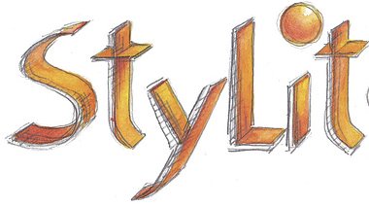
Illumination-Guided Example-Based Stylization of 3D Renderings
UE:IG3DA, Student: Mario Viti

Slide 2
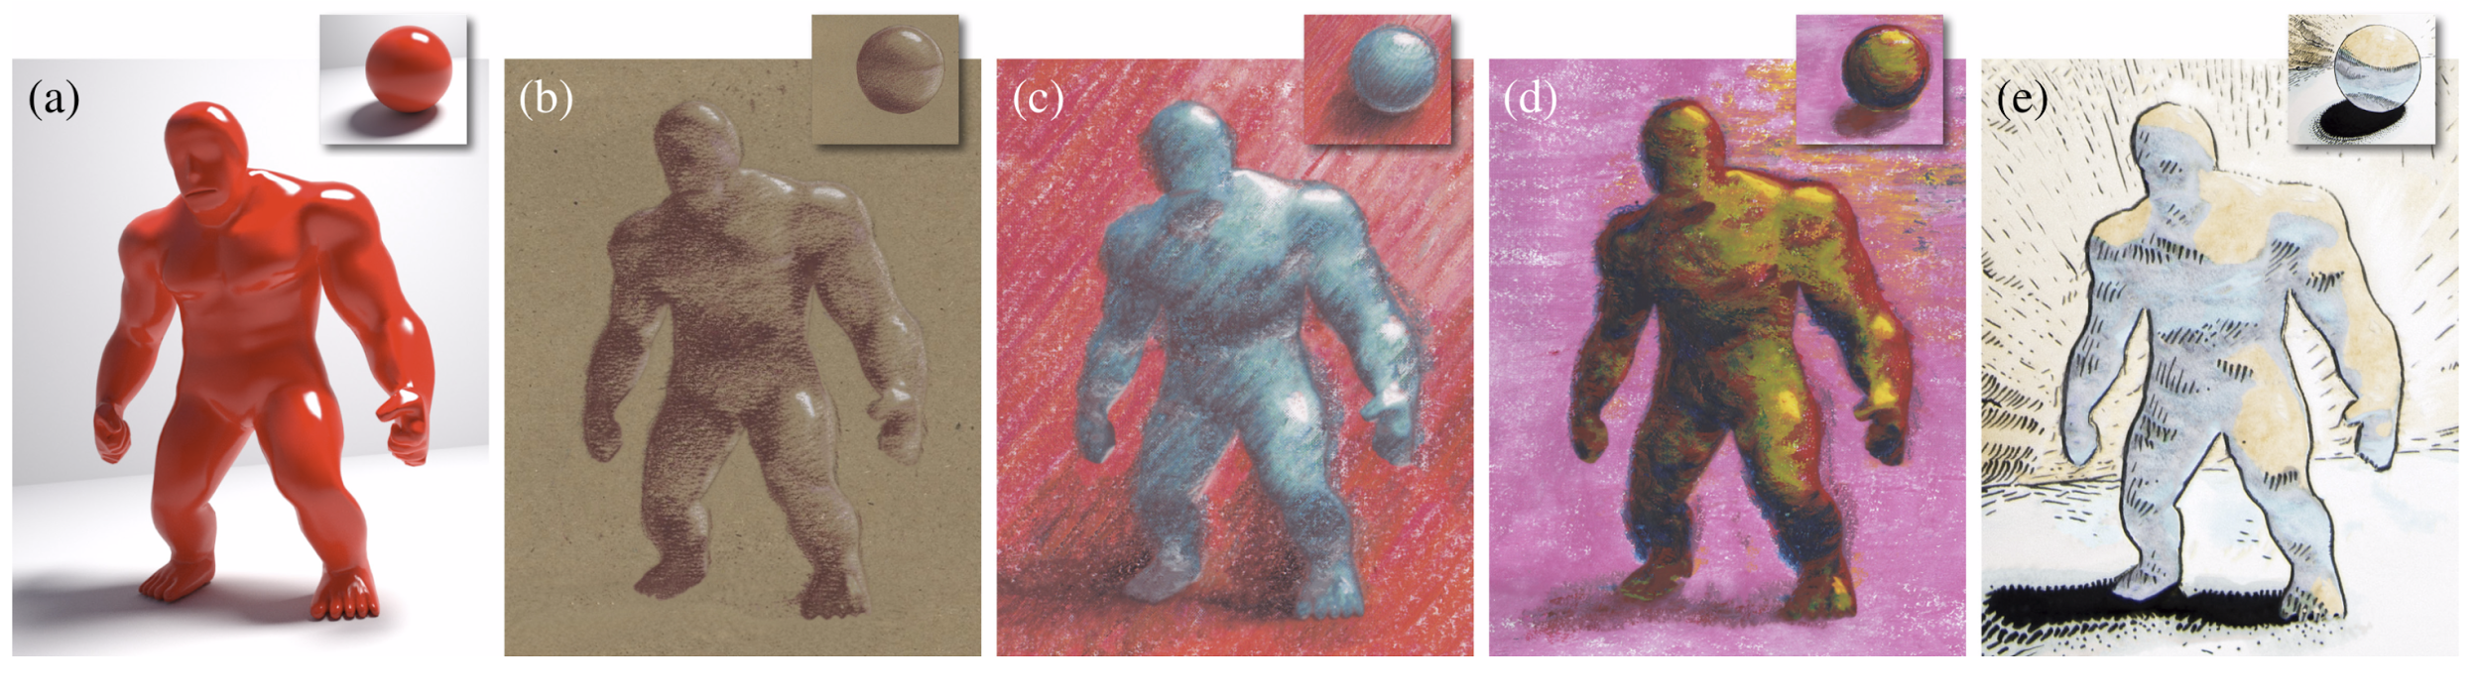
Stylit: Illumination-Guided Example-Based Stylization of 3D Renderings
Notes:
Stylit: Illumination-Guided Example-Based Stylization of 3D Renderings: an approach to example-based stylization of 3D renderings that better preserves the rich expressiveness of hand made
artwork.

Slide 3
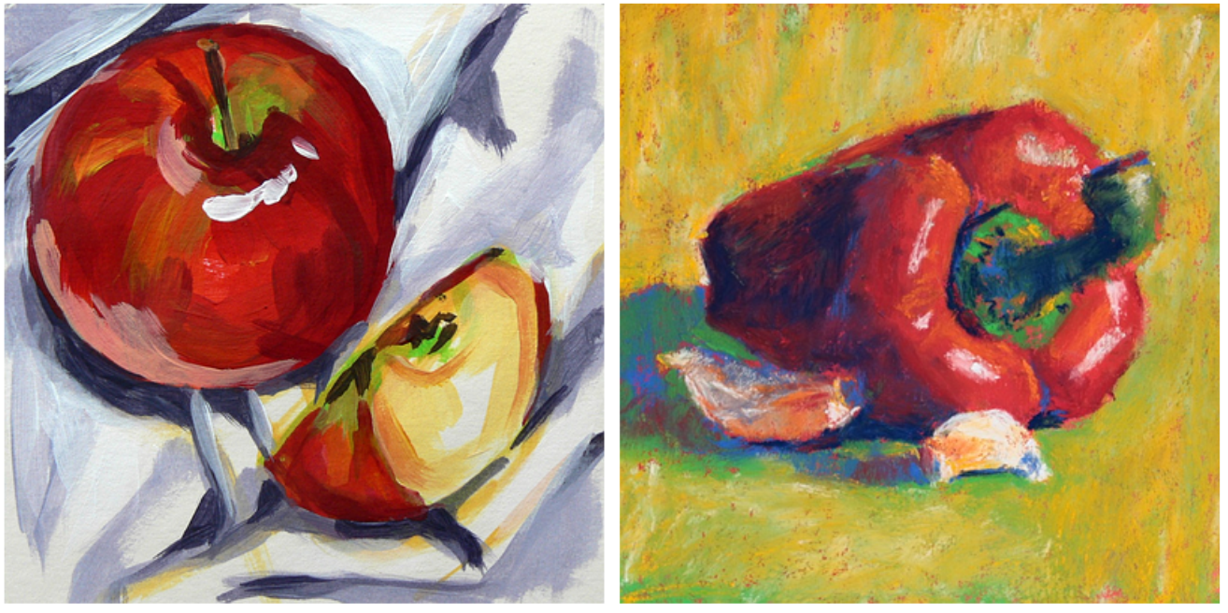
Artistic hand made style
Self Shadow Cast Shadow Indirect reflection Reflection highlights Color Texture
Notes:
An artistic hand made style can represent the same object but result in diffrent images, the style can be described by decompising it into its main factors: shadowing, lighting and reflections are unique expressions of a particular style

Slide 4
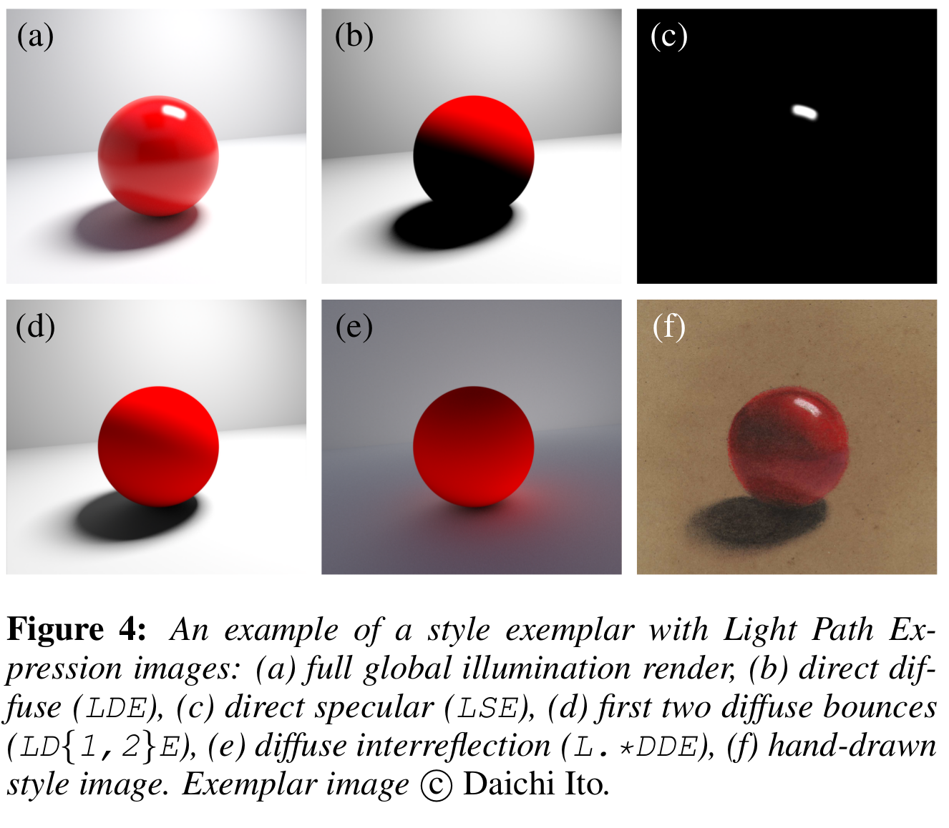

Light Path Expressions
Separated Maps: Based on the fundamental property of “Physically plausible BRDF”
Multiple Bounces diffuse:
interreflection: isolated Global Illumination term of indirect lighting Many options (Montecarlo,Radiosity,Surfels)*
* rendered with
Notes:
Photorealistic rendering can be also be decomposed into terms and factors that contribute to the overall look or render of a scene, this decomposition it’s described mathematically by render equations like the Bidirectional reflectance distribution function. These terms and factors separated are known as LPE or light path expressions.

Slide 5
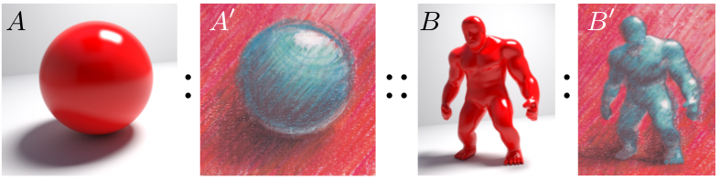
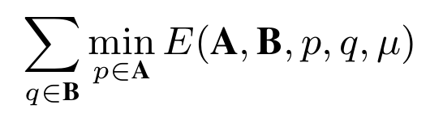
Image analogies
Analogies are defined by a global energy A = [A,A’], B = [B,B’]
The Target result is the image B that minimizes the global energy
Source LPE
Source Style
Target LPE
Target Style
Notes:
We can use analogies to compare this 2 different kind of images and theorize correspondences between synyhetic and hand made images of the same subject.
A shpere is both represented as a syntethical image composed of LPE channels A and an hand made style A’.
The goal of this analogy is to synthesize a hand made styled version of target B only from images A, A’ B.
We can formulate this problem in optimization terms by defining the energy function E as the weighted sum so square diffrences between A A’ and BB’

Slide 6
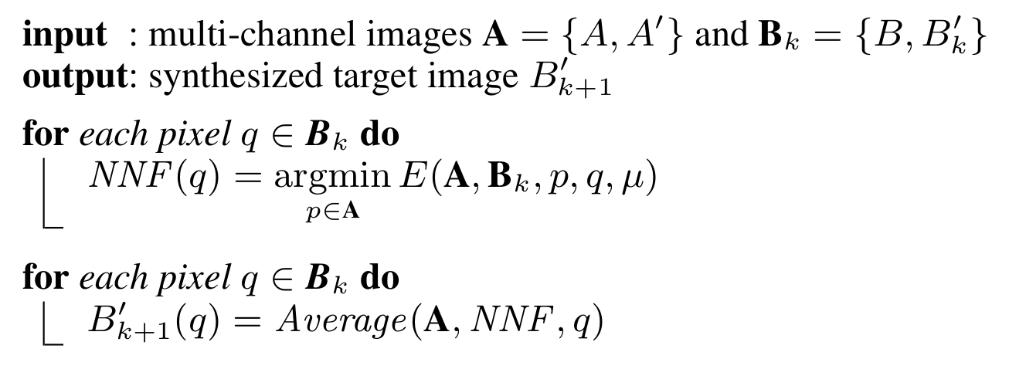
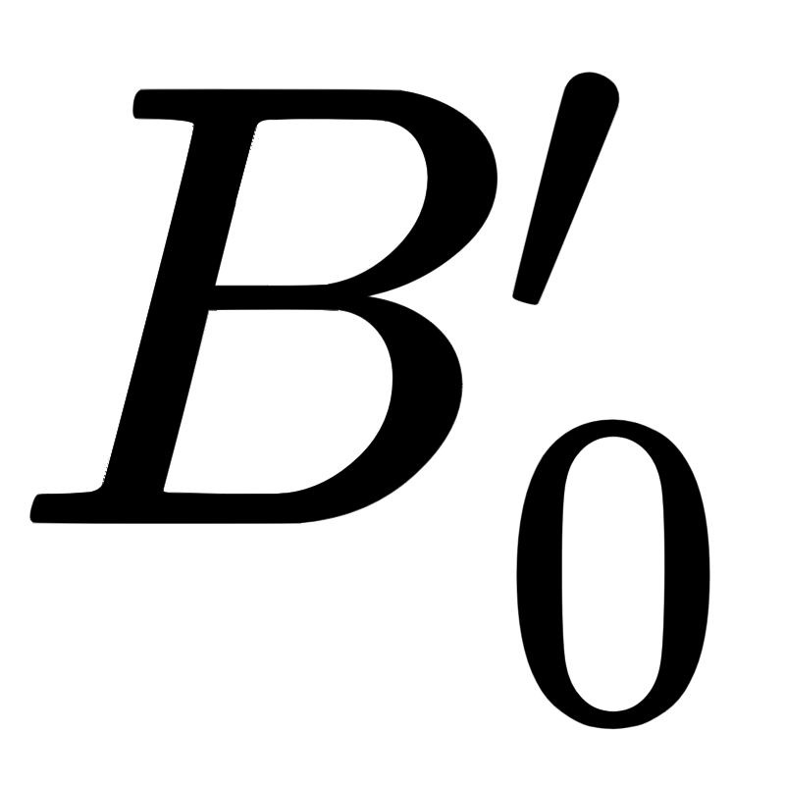
E-M optimization
NNF: nearest neighbour field (E STEP) Assignment by averaging neighbourhood NNF(q) (M STEP) random initialization.
Notes:
THe authors designed an iterative approach to minimize this Energy.
First the nearest neighbour in terms of the energy E is found for each patch of B in A and it is than assigned to it in the reconstricted target image B’
this iterative approach repeats this 2 steps several times in order to reduce the energy E

Slide 7
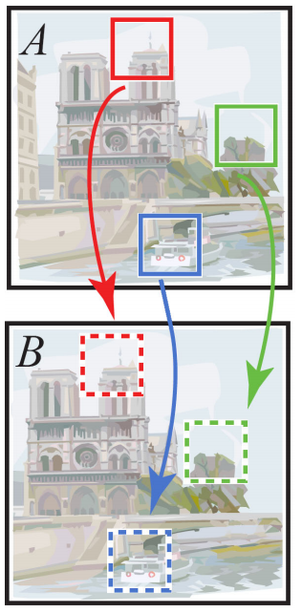
PATCH MATCH
The algorithm alternates 2 main phases:
Propagation
Random search
PatchMatch: A Randomized Correspondence Algorithm for Structural Image Editing [ C.Barnes, E. Shechtman, A. Finkelstein, D. Goldman]
Notes:
At the core of the stylit application to compute the NNF there’s PATCH MATCH: The insights driving this algorithm are that some good patch matches can be found via random sampling, and that natural coherence in the images allows to propagate such matches quickly to surrounding areas.
It is composed of 2 main phases: Propagation and random search

Slide 8
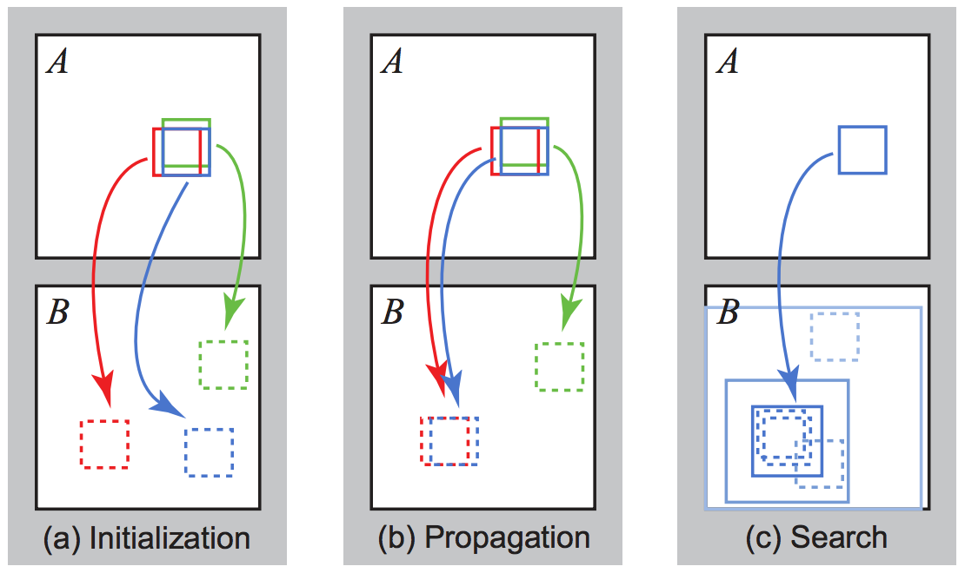
PATCH MATCH
The algorithm alternates 2 main phases:
Propagation
Random search
Notes:
first during Propagation each patch is visited in scan order (L-R,T-B) and receives 2 guesses of a better match form its L-T neighbours. Based on these guesses a new match will be chosen as the minimun of the guesses and the current best match. For pair iterations the order is inverted to Bottom right and inverse scan order.
After propagation each patch searchs randomly over a decreaslingly wide area, this step is more expensive and it has a logharithmic complexity in terms of the widest dimension of the image.

Slide 9
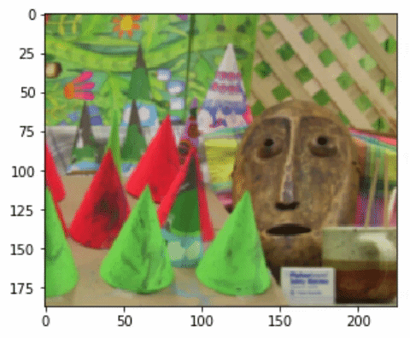
PATCH MATCH
It is used for example to estimate disparity within 2 similar image with a translational offset.
Notes:
This algorythm is approximated but very rapid. Most noticealble application is the computation of a disparity map between similar images.

Slide 10
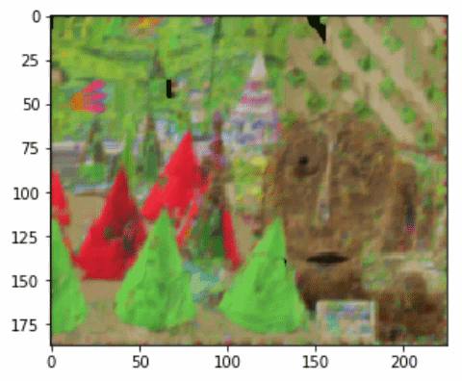
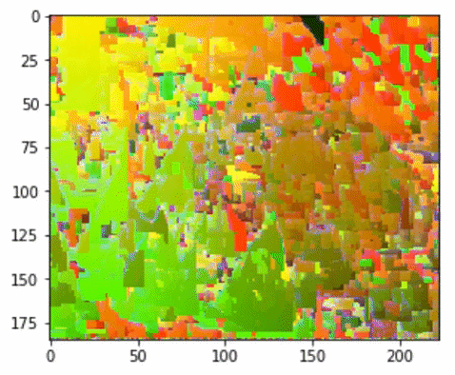
PATCH MATCH
Notes:
5 iterations are enough to converge to a reconstruction as suggested from the authors.

Slide 11
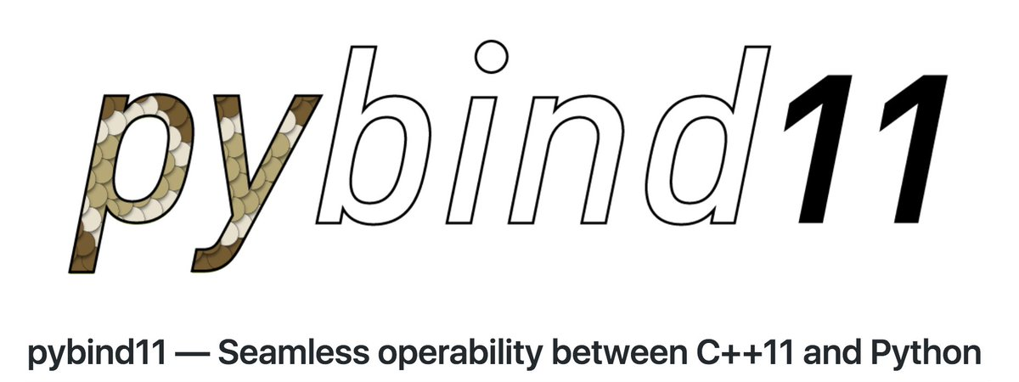
IMPLEMENTATION
Languages/libraries: python, c++, pybind, scipy.
5 iterations on a 180x220 image : 1.54 +- 0.02 sec
c++ - python wrapper library:
Pybind 11 hallows communication between python and c++ environments.
Notes:
THe algorithm has been implemented in c++ and it converges in 1.5 seconds to an acceptable reconstruction.

Slide 12
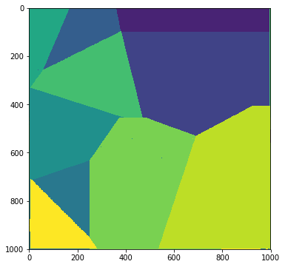
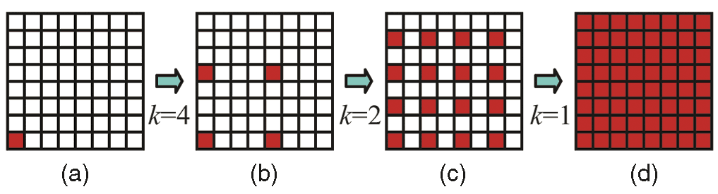
EXTENSION: JUMPING FLOOD
Efficient communication pattern for parallel applications.
seed position in red, non seed in white.
the seed communicates its position in a copy grid, non seed locations reading the communication and updating to nearest seed.
d) flooding occupies all the grid.
Jump Flooding in GPU with Applications to Voronoi Diagram and Distance Transform [ G. Rong, T. Tan.]
Notes:
Although the propagation step is inheritably a serial operation it can be parallelized by using the jumping flood communication paradigm. This algorithm has been developed and shown its efficacy in computing voronoi diagrams with a Logarithmic number of calls to GPU. The authors of the PatchMatch algorithm hints to this solution however no further detail is available on its implementation. Jumping flood original algorithm is implemented in OpenGL, but a I developed a CUDA version.

Slide 13
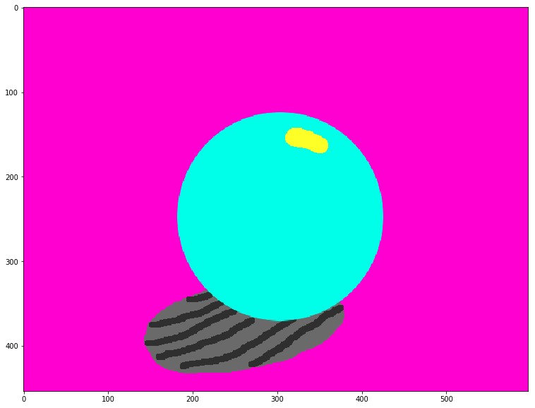
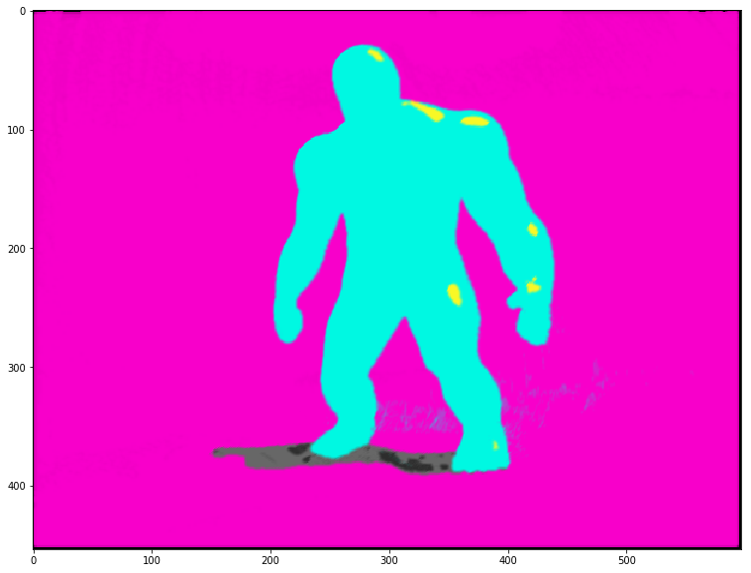
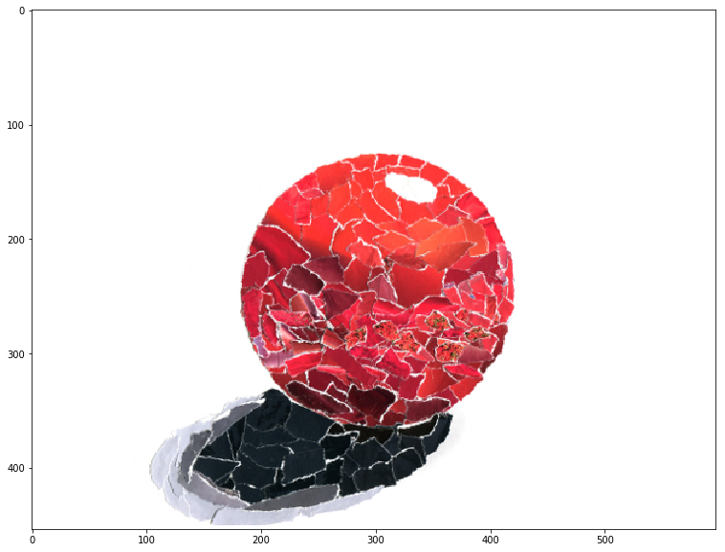
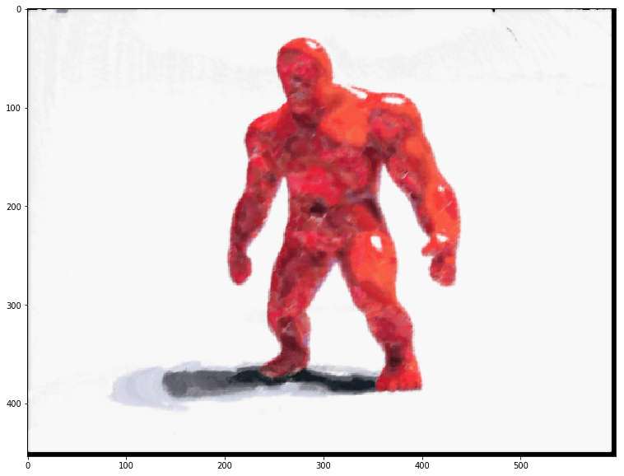
Notes:
This are some result of the application of PATCH MATCH to style transfert.
The authors of the stylit algorithm underlines how this is a suboptimal solution because of the wahsed out effects.

Slide 14
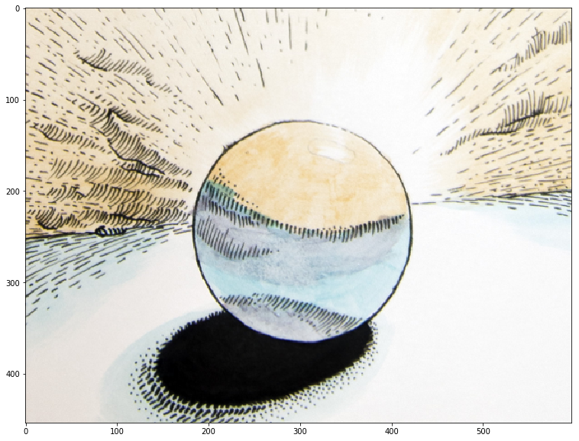
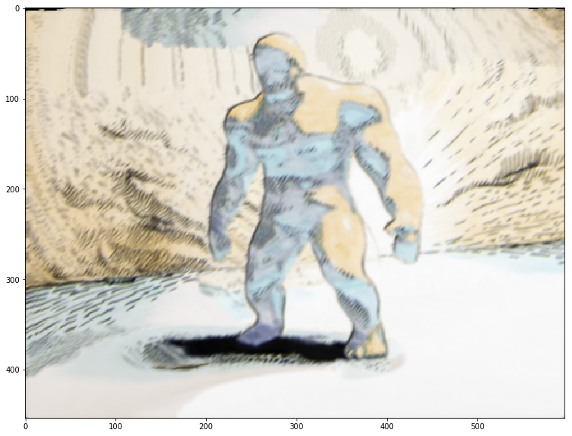
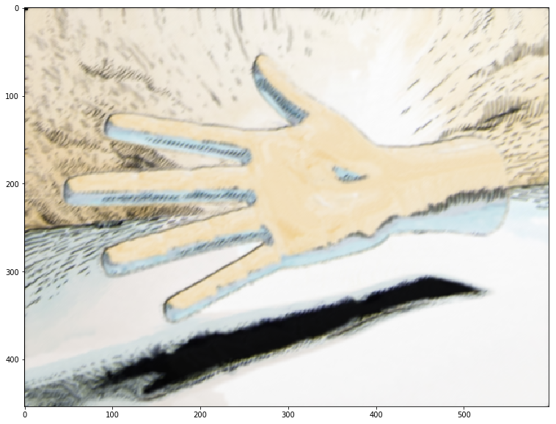
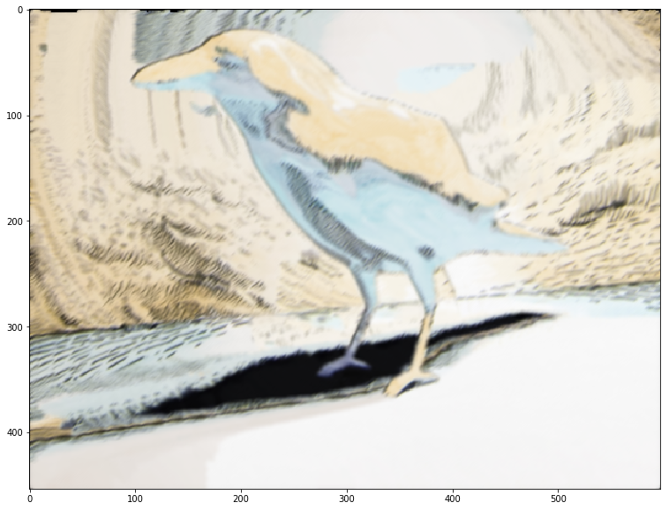
Notes:
It also fails to represent analogies for more complex styles

Slide 15
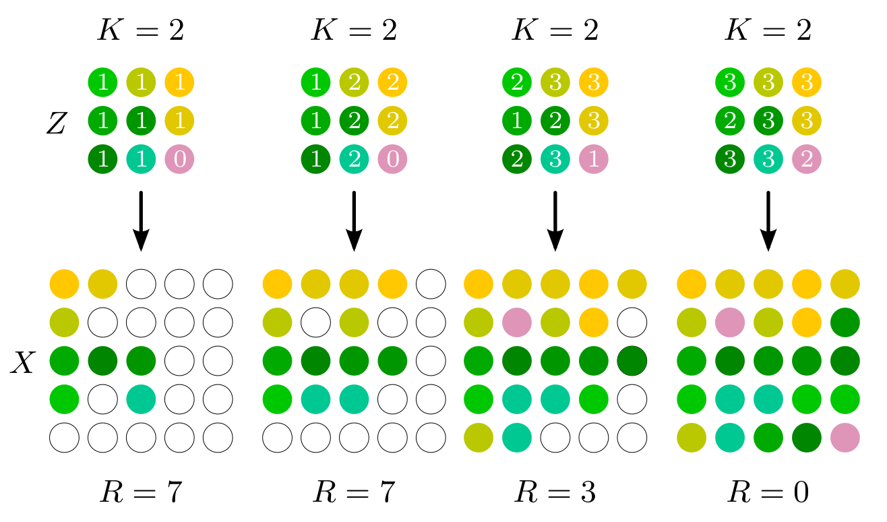
Reversed NNF
NNF
Source LPE
Source Style
Target LPE
Target Style
LazyFluids: Appearance Transfer for Fluid Animations [ J. Fiser et al.]
Notes:
Authors suggested to use another approach: reversing the direction of the NNF.
In this case each patch of the source will be assigned to its best location in the target.
However because of collisions some patches of the sources might not be assigned leaving holes in the target.
The Reversed NNF stragegy proposes to repeat the retrival until all patches in the target are assinged

Slide 16
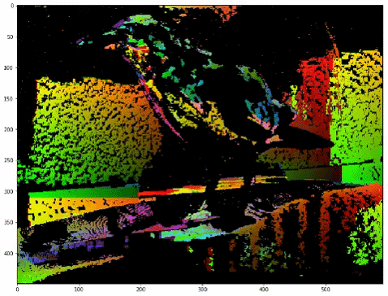
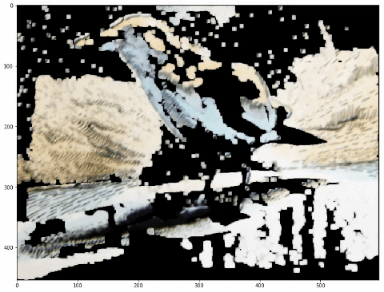
Reversed NNF

Slide 17
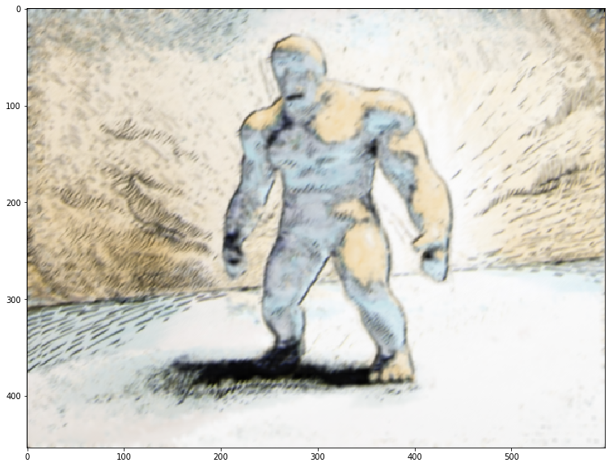
NNF vs ReversedNNF

Slide 18

NNF vs ReversedNNF

Slide 19
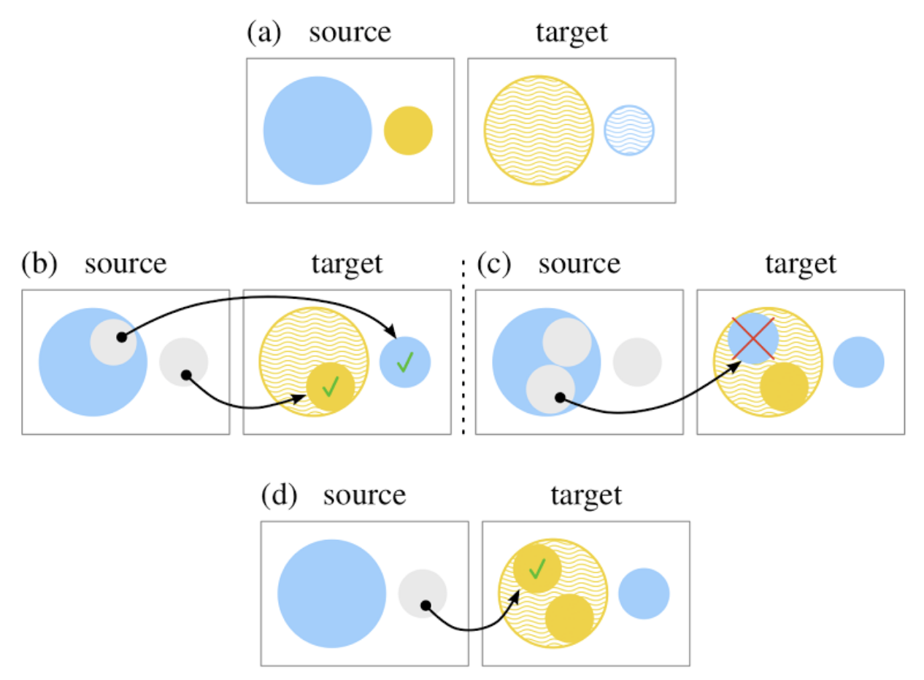
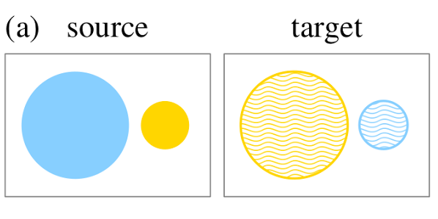
Uniform patch usage
A best matching target patch is retrieved for each source patch (b). When scanning the source best matching location for patches in the target might be already covered. This leads to erroneous assignments. So one might want to reuse source patches.
Notes:
A best matching target patch is retrieved for each source patch (b).
When scanning the source best matching location for patches in the target might be already covered.
This leads to erroneous assignments.
So one might want to reuse source patches.

Slide 20
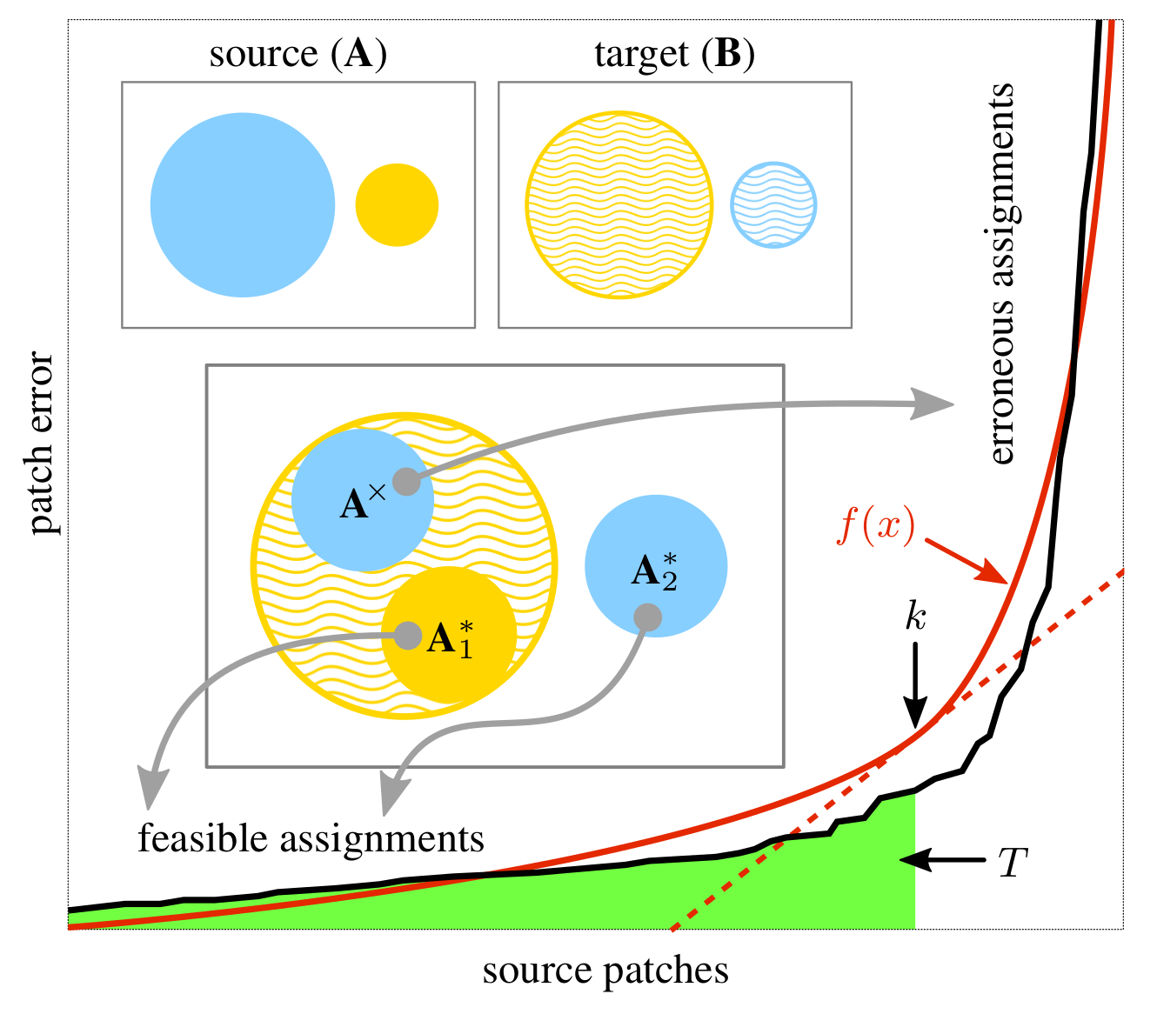
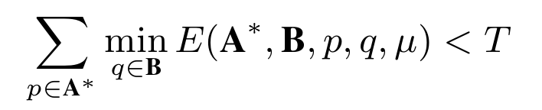
Uniform patch usage
Enforce uniform patch by reversed NNF retrieval [ Jamriska Fiser et al.] Apply this method correspond to the application of a Budget constraint on the Energy.
Notes:
The sorted assigment error has an hyperbolic profile, so it is possible to predict the best use for a patch by removing its assignement by computing an error threshold at the knee point

Slide 21
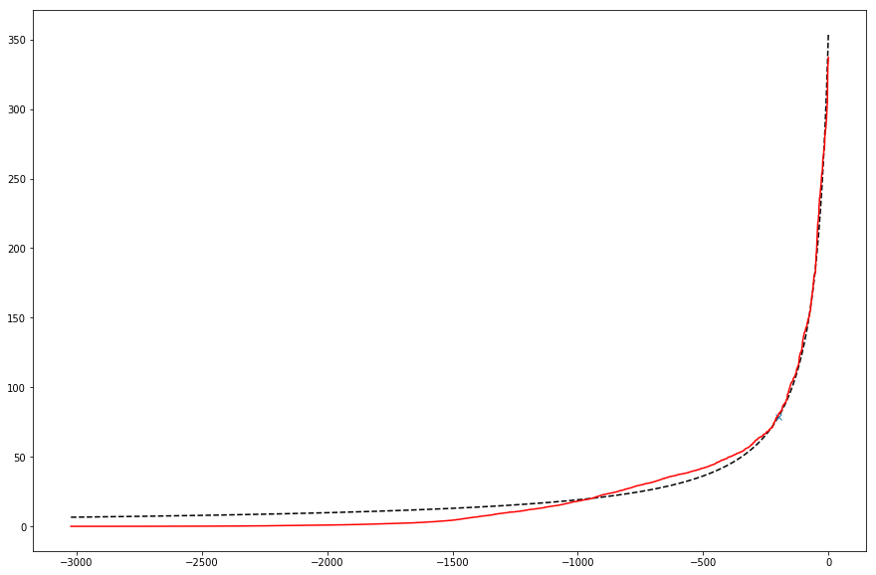
Assignments
Same error is observed after reversed NNF retrival. COMPUTATION: sorting hyperbole fitting
error
patches assignments
Notes:
After the execution I could identify the same profile

Slide 22
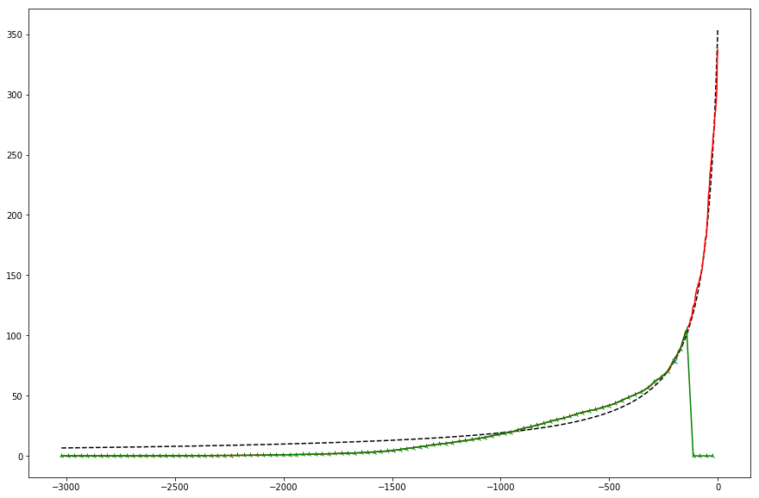
Assignments
Statistical approximated approach. PROS: Save computation: no need for sorting. CONS: it is approximated (biased) by observations.
error
patches assignments
Notes:
However I noticed that a simpler approach leads to similar conclusion, by computing the mean and standard deviation of the error I could compute a very similar threshold.
As a pro this method is less complex as it does not need sorting but it is also biased by observation.

Slide 23
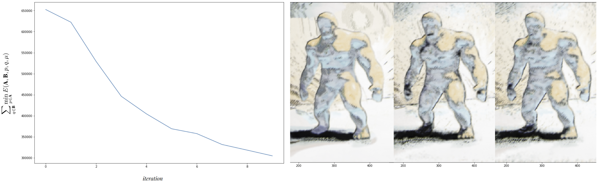
Energy minimization
Notes:
By simply applying this method after each reversed nnf match the overall energy for assignments decreases almost exponentially.

Slide 24
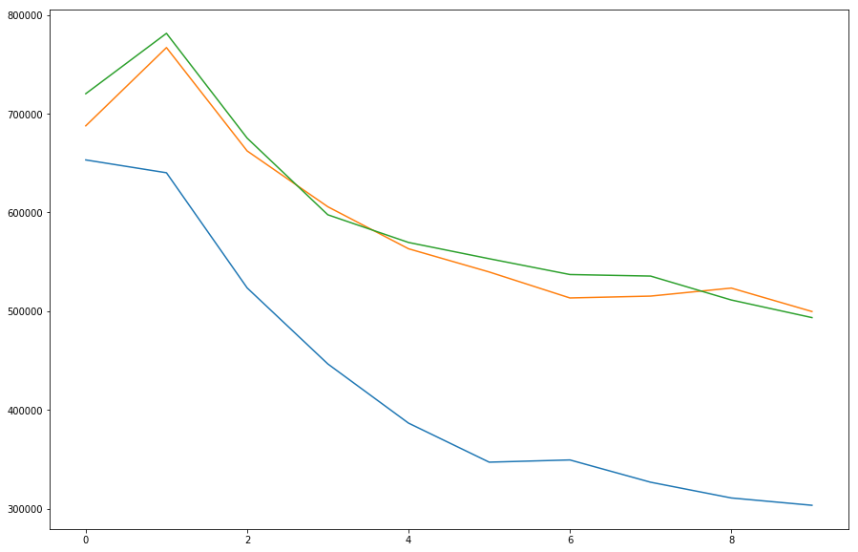
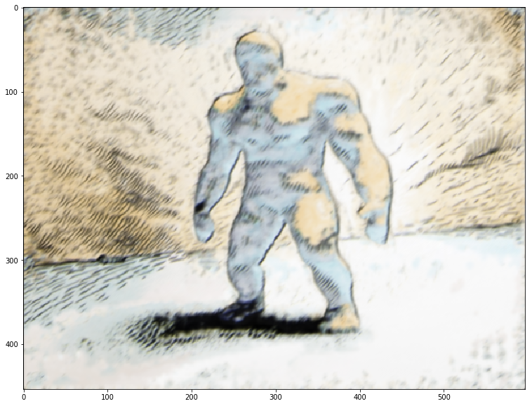
EM
iteration
Notes:
Best results are achieved when all previous techniques are mixed with the EM iterative approach.
After 3 iterations here’e the resutls notice the contours on the left harm.
Better results might be achieved with original images, the provided samples are half the resolution of the originals.

Slide 25
Thank you.

Slide 26
References
StyLit: illumination-guided example-based stylization of 3D renderings, [ J FIŠER, O JAMRIŠKA, M LUKAC, E SHECTHMAN, P ASENTE, J LU, D SÝKORA ]
PatchMatch: A Randomized Correspondence Algorithm for Structural Image Editing, [ C BARNES, E SHECTMAN, A FINKELSTEIN, D GOLDMAN ]
LazyFluids: Appearance Transfer for Fluid Animations, [ O JAMRIŠKA , J FIŠER , P ASENTE , J LU , E SHECHTMAN ]
Jump Flooding in GPU with Applications to Voronoi Diagram and Distance Transform [ G RONG, T TAN ]

